Slide 1
COMMUNITY CONNECT BHAGAWAD GITA GROUP PRESENTATION
K.HARSHITHA ;BT18GCS087
K.MONIKA ;BT18GCS084
ASHWINI ;BT18GCS055
SECTION : S2

Slide 2


Slide 3
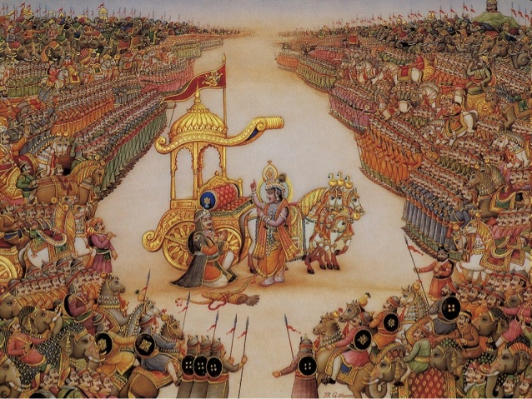

Slide 4
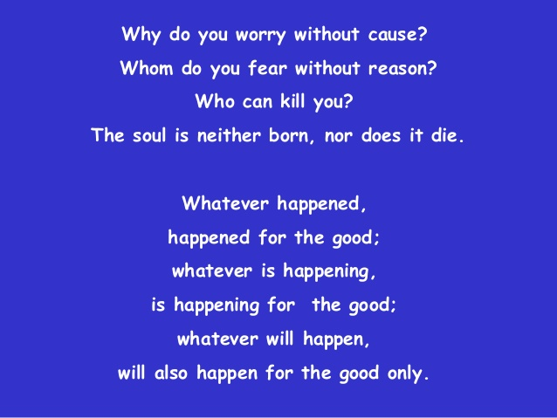

Slide 5
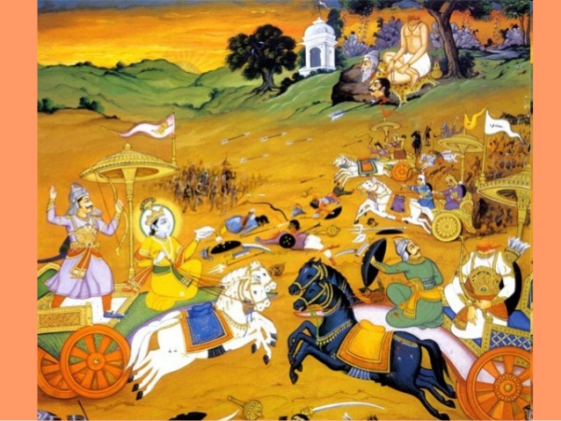

Slide 6
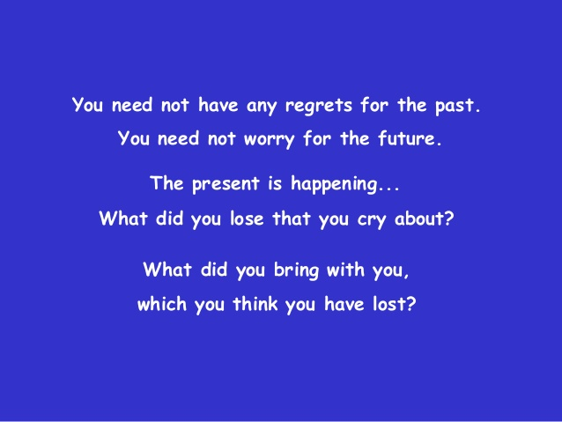

Slide 7
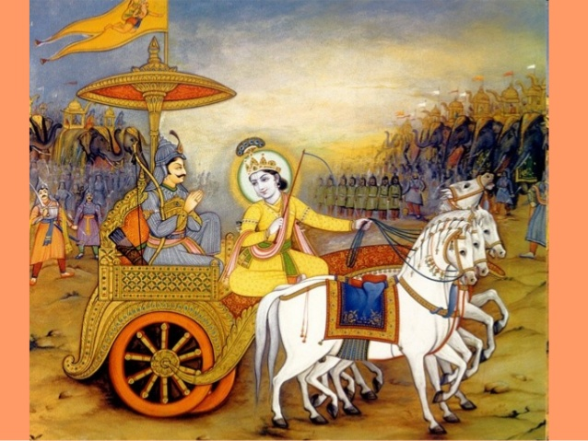

Slide 8
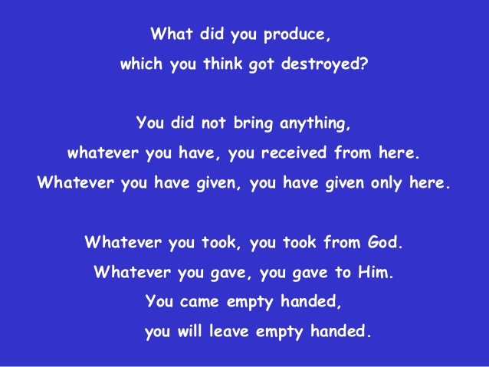

Slide 9
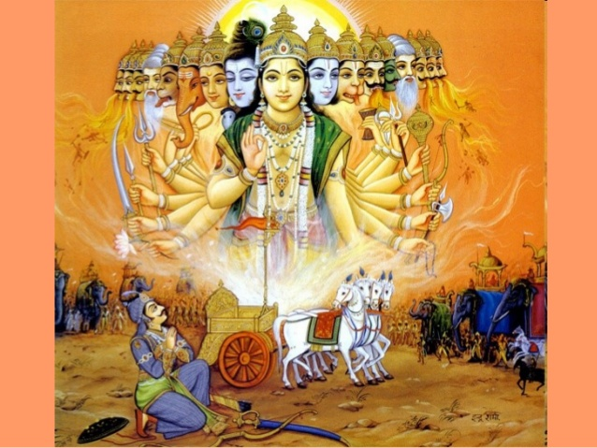

Slide 10


Slide 11
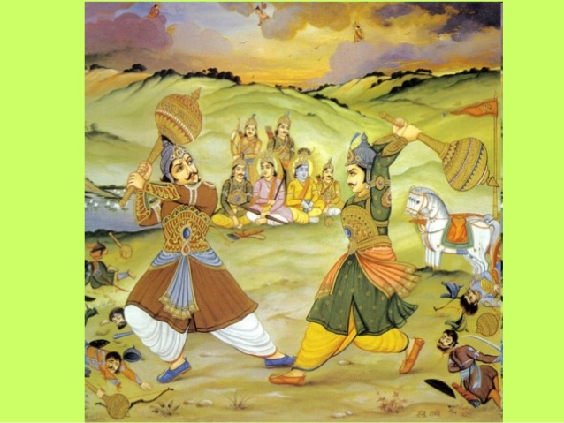

Slide 12


Slide 13
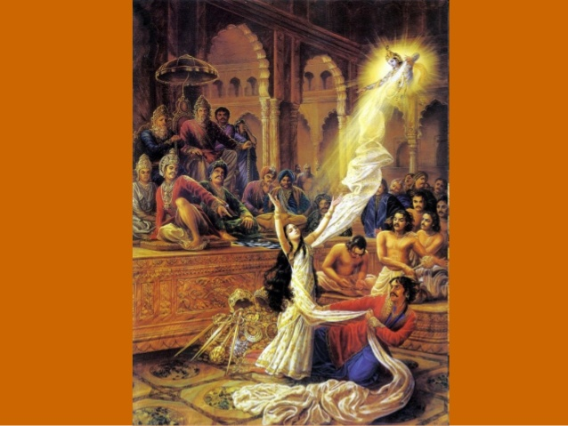

Slide 14
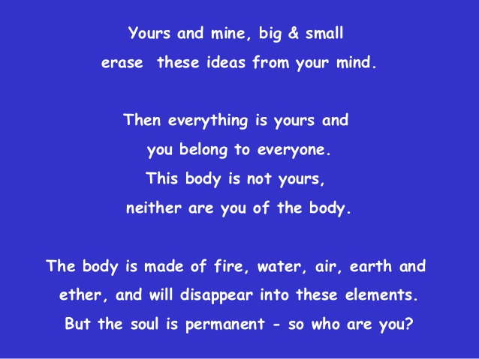

Slide 15
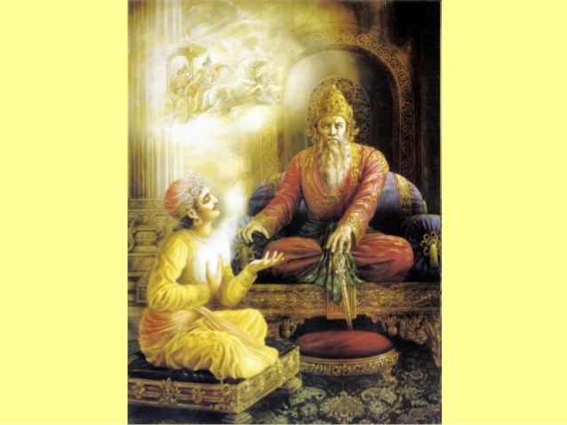

Slide 16


Slide 17
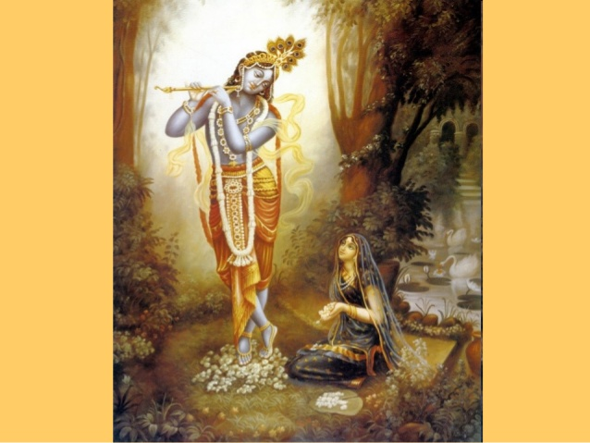

Slide 18
THANK
YOU

